Slide 1

Internet vandalism
20x20
Roman
Matveev

Slide 2
What is it?
It is destroying thing in/by the internet sphere by means of malware or direct manual interacting with victims.

Slide 3
Who are they?
Skilled students. Indeed, vice-chairman of Sberbank Stanislav Kuznecov stated:
“Nearly every third cyber perpetrators are 14-15 old”.
Professional developers
Researchers

Slide 4
Reasons of a reduction in the number of ‘traditional’ types of threats
New laws
Games
Complexity

Slide 5
How to protect yourself?
Antimalware software
Cyber hygiene

Slide 6
More specialized – website vandalism
It is changing the content of a website without owner approval.
Often low-cost and simple in implementation

Slide 7
Reasons
To draw attention to a political cause
Electronic graffiti
Aesthetic appearance
Injecting malicious code into websites
Competition
Altering encyclopedia articles

Slide 8
Effects
Losing customers
Disrupting or stopping e-business activity
Damage to your reputation.
Mispresentation
Disrupting of service of crucial sites

Slide 9
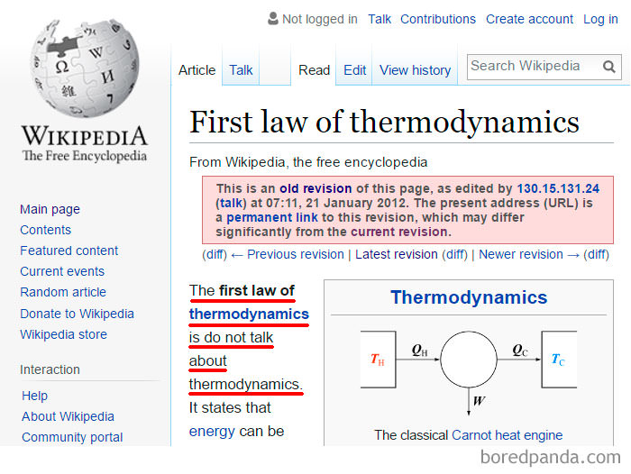
Cases

Slide 10
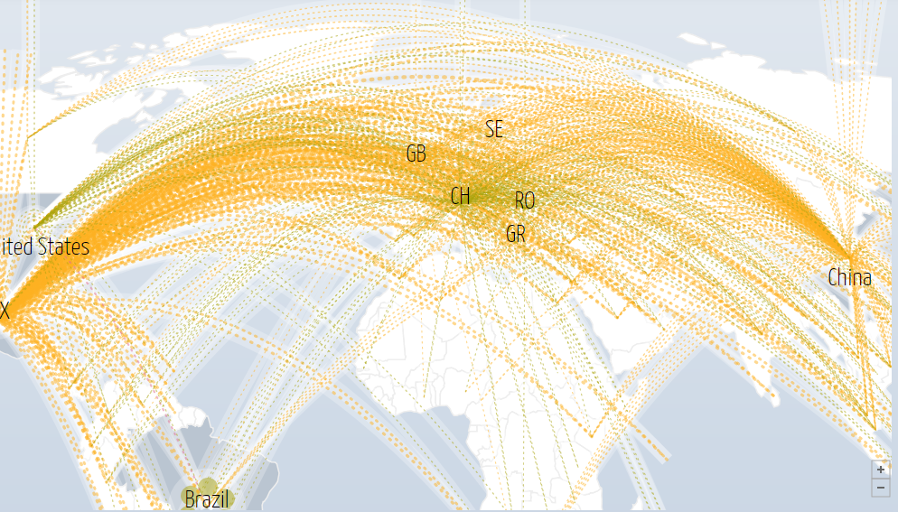
Example

Slide 11
Sources
https://imgur.com/gallery/8ynfr
https://www.kaspersky.com/resource-center/threats/computer-vandalism
http://www.digitalattackmap.com/#anim=1&color=0&country=ALL&list=0&time=17849&view=map
https://www.staysmartonline.gov.au/protect-your-business/recover-when-things-go-wrong/website-vandalism

